Slide 1



High Cloud Airlines Performance Analysis

Slide 2


Presentation by:
NAVADEEP
ADITHYA
SAI

Slide 3

Project Objective
To analyze High Clouds Airline data and understand overall industry trends.
To identify popular and underrated Airlines based on location and flight count
To analyze the impact of weekday/weekend and distance on load factor
Analyze passenger demand and unused seat capacity for operational optimization.
Identify top-performing carriers and busiest flight routes.
To provide data-driven insights that help airlines improve pricing, service, and location strategy

Slide 4
Client Problem Statement
The airline lacks visibility into flight performance across different routes and carriers, making it difficult to evaluate overall operational efficiency.
The management is unable to identify underutilized flights and unused seat capacity, resulting in inefficient resource utilization.
The client requires analysis of passenger demand, load factor, top-performing carriers, and route performance to support capacity planning and operational improvements.
The client needs to identify travel patterns based on weekends vs weekdays, flight distance groups, and source-to-destination routes to optimize network planning and improve service efficiency.

Slide 5
Challenges Faced (Module-wise)
Excel
Designing dynamic dashboards using pivot tables and slicers without affecting data accuracy
Ensuring slicers affected only relevant visuals without impacting unrelated KPIs
Power BI
Creating accurate relationships and measures for dynamic dashboards
Implementing bookmarks, page navigation, and reset filters.
Tableau
Designing clear and interactive dashboards with proper filters
Applying filters across multiple worksheets.

Slide 6
Steps Taken to Solve
1
Taken and understood the dataset
4
Built pivot tables and Excel dashboards for quick analysis
2
Cleaned the data using Excel by handling missing values and inconsistencies
5
Created interactive dashboards in Power BI and Tableau for visualization
3
Performed data analysis and complex queries using SQL for insights extraction
6
Analyzed insights and summarized findings for business decision-making

Slide 7
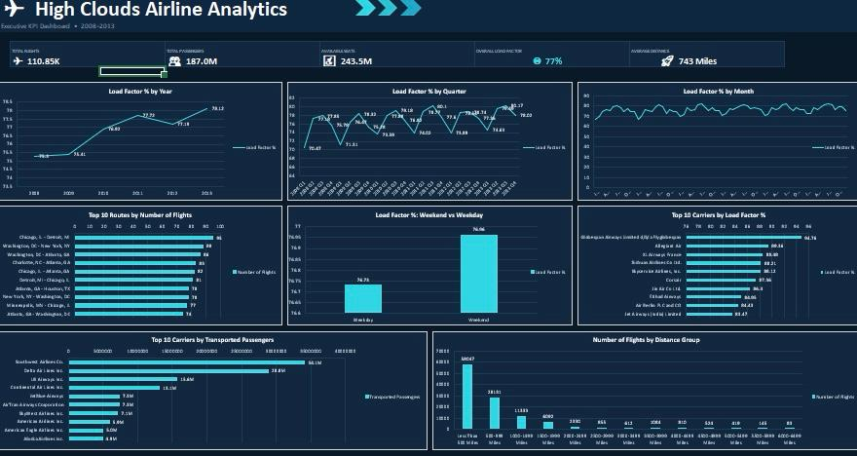
Excel Dashboard

Slide 8
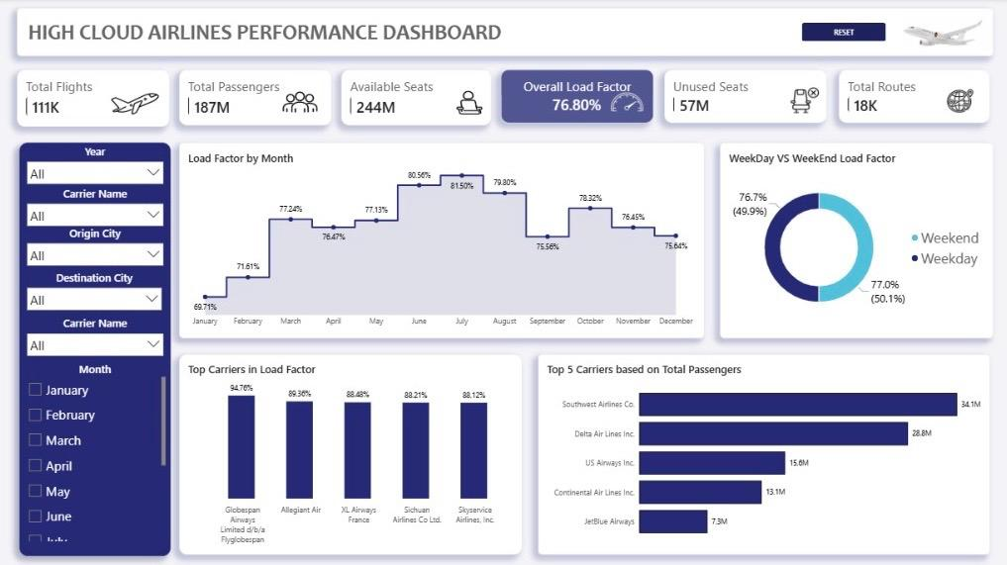
PowerBI Dashboard-1

Slide 9
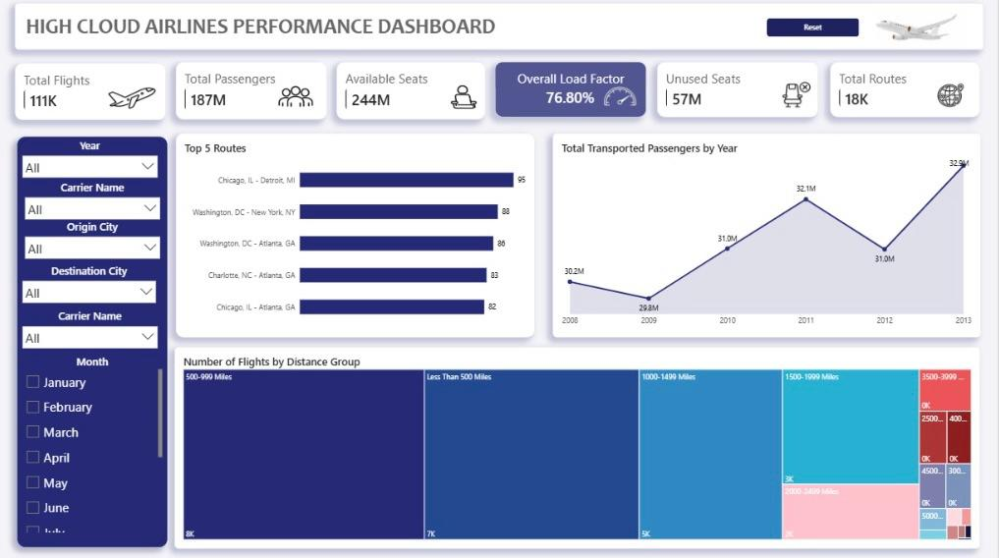
PowerBI Dashboard-2

Slide 10
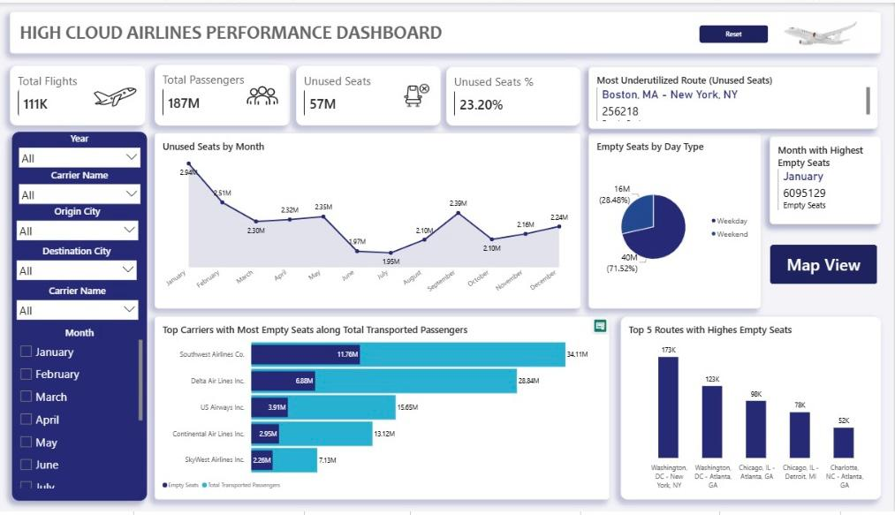
PowerBI Dashboard-3

Slide 11
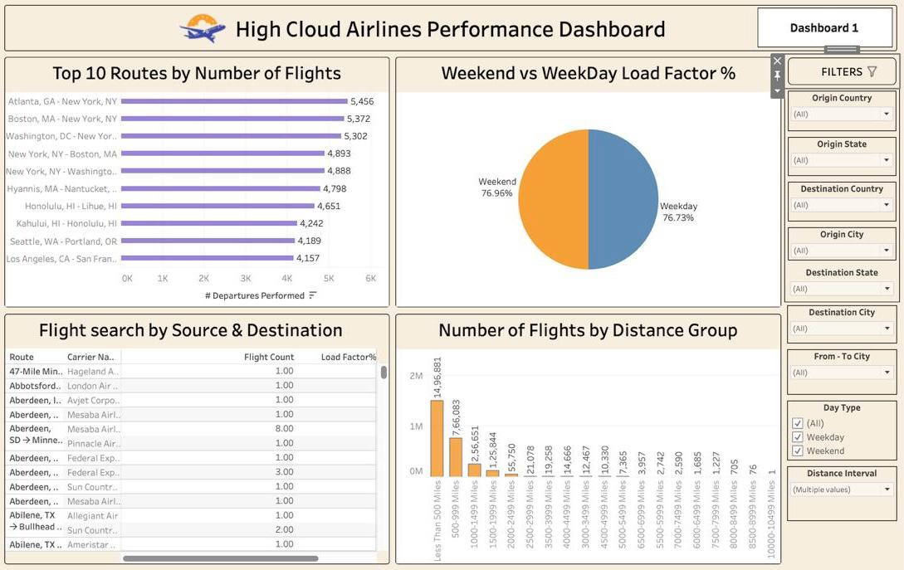
Tableau Dashboard-1

Slide 12
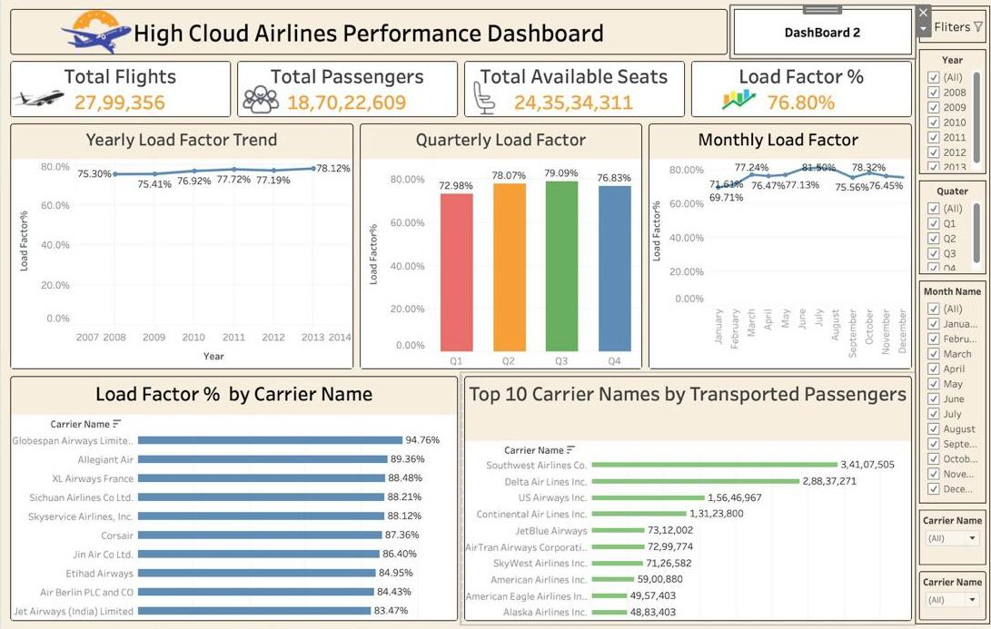
Tableau Dashboard-2

Slide 13
Key Business Insights
Overall Load Factor remained around 76.8%, indicating efficient seat utilization.
Southwest Airlines transported the highest number of passengers.
Certain routes consistently experienced the highest flight traffic.
January recorded the highest number of unused seats.
Short-distance flights accounted for the majority of departures.
Weekend Load Factor was slightly higher than weekday performance.
Interactive dashboards provide faster decision-making through dynamic filtering and KPI monitoring.

Slide 14
Conclusion
This project demonstrates how data analytics can improve airline operations by:
Monitoring operational KPIs
Optimizing seat utilization
Identifying high-demand routes
Evaluating carrier performance
Supporting strategic business decisions through interactive dashboards

Slide 15
Thank You
Questions & Discussion

